Slide 1


Why Mobile Banking is Popular
Hasitha Jayasundara
209400C
MSC in Computer Science
CS5651-Statistical Inference

Slide 2
Introduction
Objective- To understand why customers tend to use Mobile Banking
Sample – Sample is based on the data which I received as responses for my google form and which has covered a sample from the actual population of sri Lankan elders which are above 19 years.
Tools- Power Bi with the support of python scripting

Slide 3
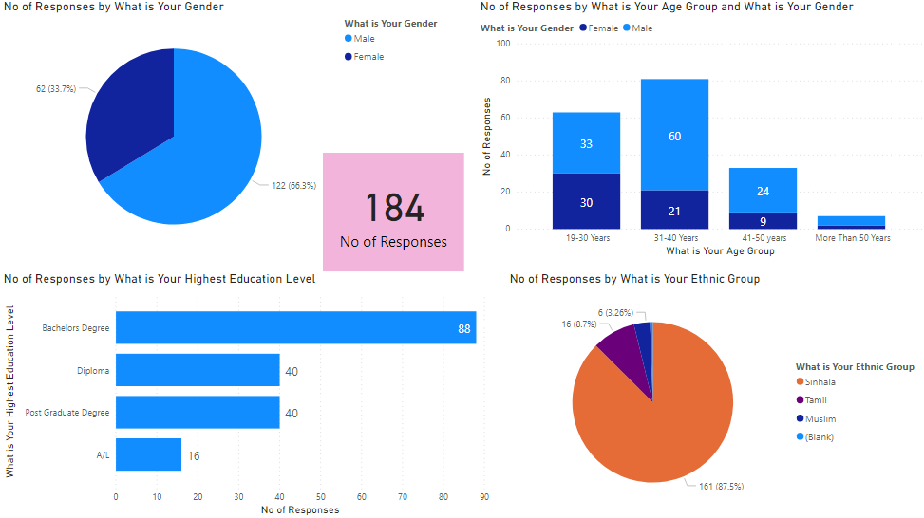
209400C-Hasitha Jayasundara

Slide 4
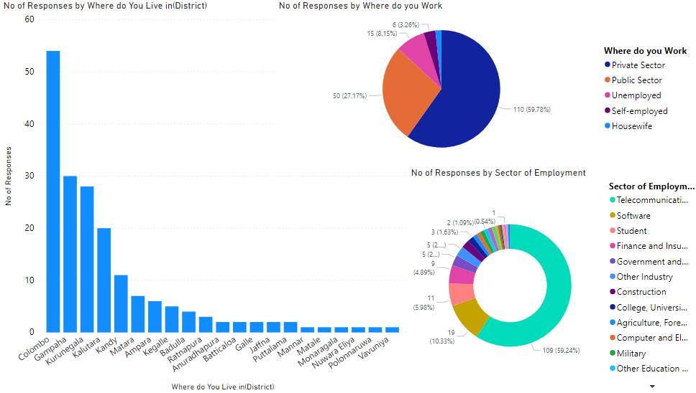
209400C-Hasitha Jayasundara

Slide 5
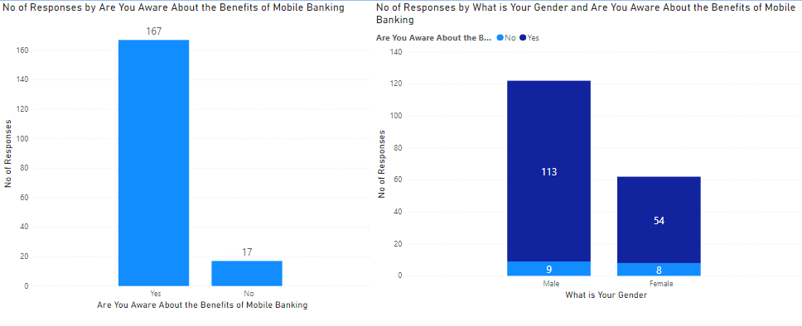
Awareness about Mobile Banking
209400C-Hasitha Jayasundara

Slide 6
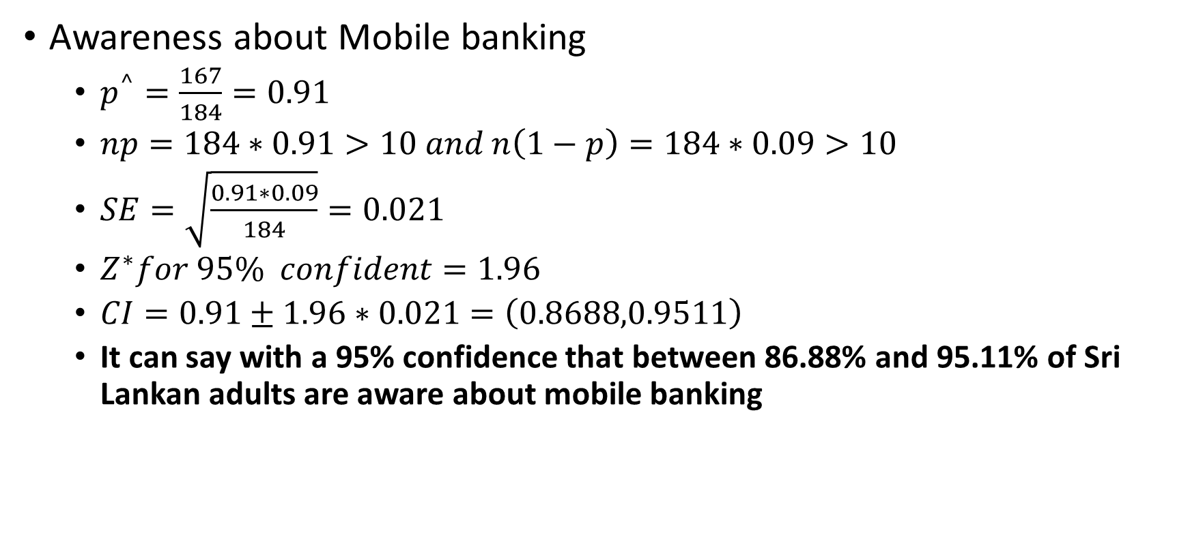
Statistical Inference-Awareness about Mobile Banking
209400C-Hasitha Jayasundara
Awareness about Mobile banking
$p^{^}=\frac{167}{184}=0.91$
$np=184∗0.91>10 and n\left(1−p\right)=184∗0.09>10$
$SE=\sqrt{\frac{0.91∗0.09}{184}}=0.021$
$Z^{∗}for 95\% confident=1.96$
$CI=0.91±1.96∗0.021=\left(0.8688,0.9511\right)$
It can say with a 95% confidence that between 86.88% and 95.11% of Sri Lankan adults are aware about mobile banking
Yes | No
167 | 17

Slide 7
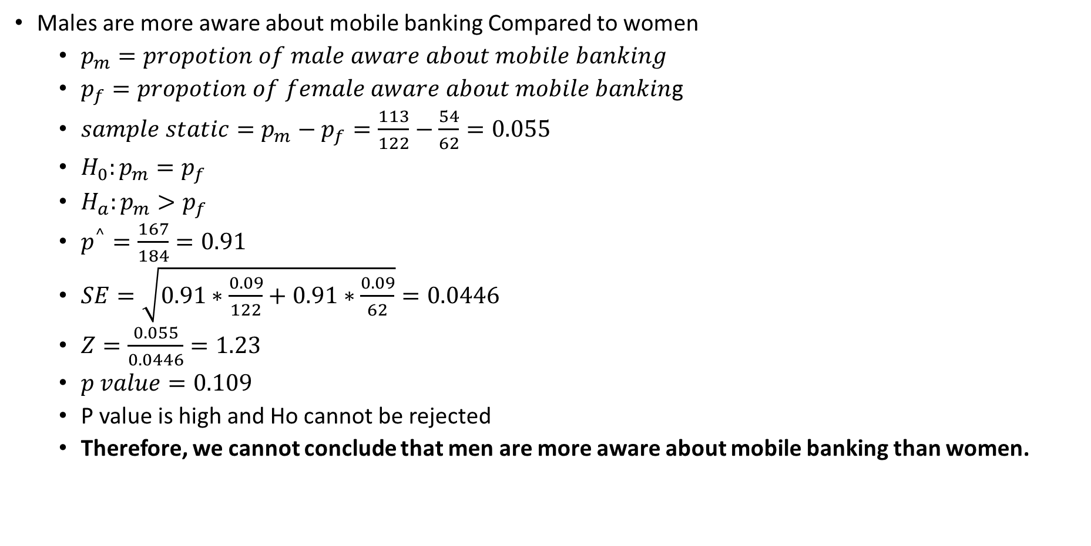
Statistical Inference-Awareness about Mobile Banking
209400C-Hasitha Jayasundara
Males are more aware about mobile banking Compared to women
$p_{m}=propotion of male aware about mobile banking$
$p_{f}=propotion of female aware about mobile bankin$g
$sample static=p_{m}−p_{f}=\frac{113}{122}−\frac{54}{62}=0.055$
$H_{0}:p_{m}=p_{f}$
$H_{a}:p_{m}>p_{f}$
$p^{^}=\frac{167}{184}=0.91$
$SE=\sqrt{0.91∗\frac{0.09}{122}+0.91∗\frac{0.09}{62}}=0.0446$
$Z=\frac{0.055}{0.0446}=1.23$
$p value=0.109$
P value is high and Ho cannot be rejected
Therefore, we cannot conclude that men are more aware about mobile banking than women.
Aware about Mobile banking | Male | Female | Total
Yes | 113 | 54 | 167
No | 9 | 8 | 17
Total | 122 | 62 | 184

Slide 8
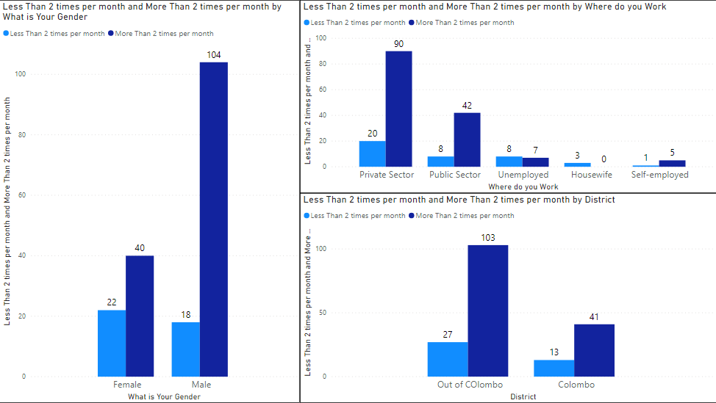
How Frequent You Are Going to Bank
209400C-Hasitha Jayasundara

Slide 9
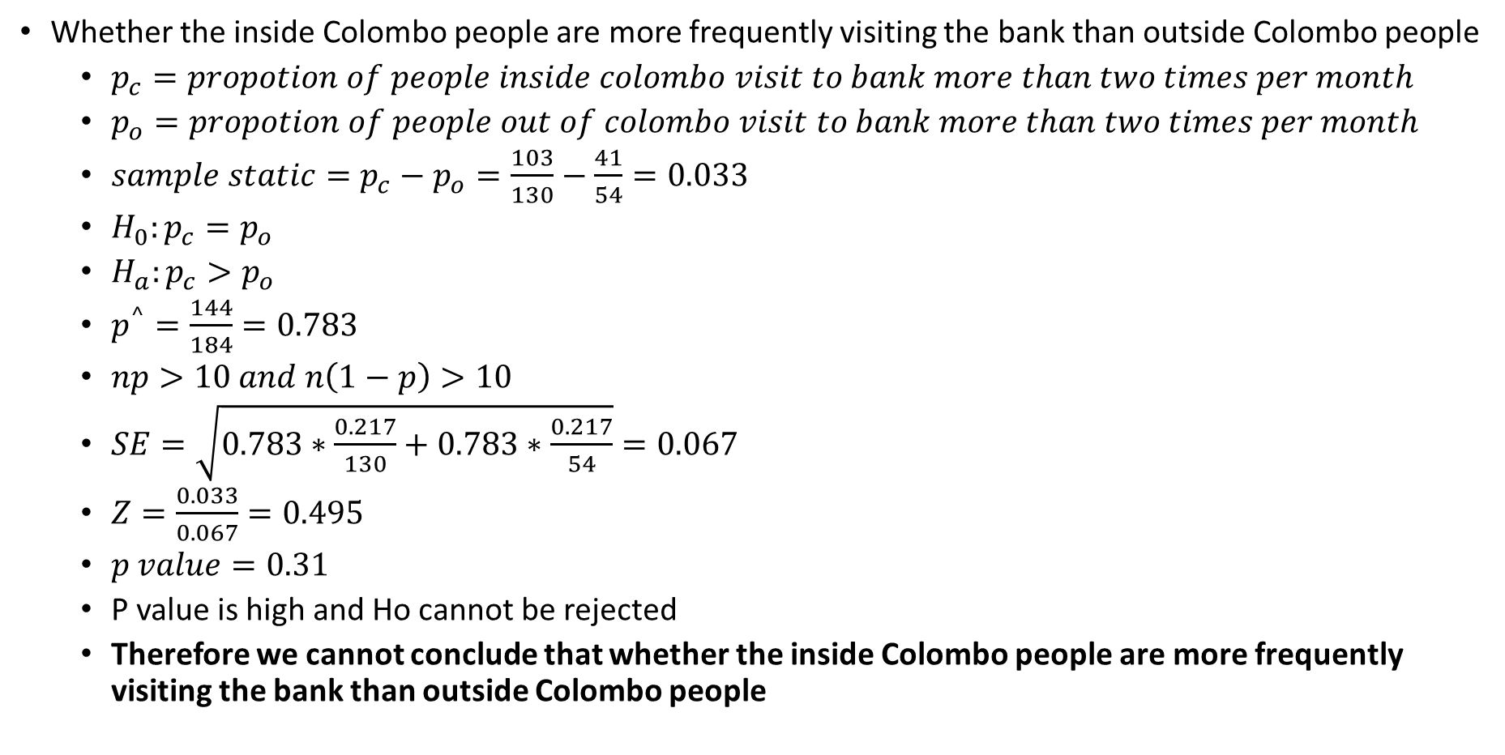
Statistical Inference-Visiting Frequency to Bank
209400C-Hasitha Jayasundara
Whether the inside Colombo people are more frequently visiting the bank than outside Colombo people
$p_{c}=propotion of people inside colombo visit to bank more than two times per month$
$p_{o}=propotion of people out of colombo visit to bank more than two times per month$
$sample static=p_{c}−p_{o}=\frac{103}{130}−\frac{41}{54}=0.033$
$H_{0}:p_{c}=p_{o}$
$H_{a}:p_{c}>p_{o}$
$p^{^}=\frac{144}{184}=0.783$
$np>10 and n\left(1−p\right)>10$
$SE=\sqrt{0.783∗\frac{0.217}{130}+0.783∗\frac{0.217}{54}}=0.067$
$Z=\frac{0.033}{0.067}=0.495$
$p value=0.31$
P value is high and Ho cannot be rejected
Therefore we cannot conclude that whether the inside Colombo people are more frequently visiting the bank than outside Colombo people
Visit More than two times per month | Within Colombo | Out of Colombo | Total
Yes | 103 | 41 | 144
No | 27 | 13 | 40
Total | 130 | 54 | 184

Slide 10
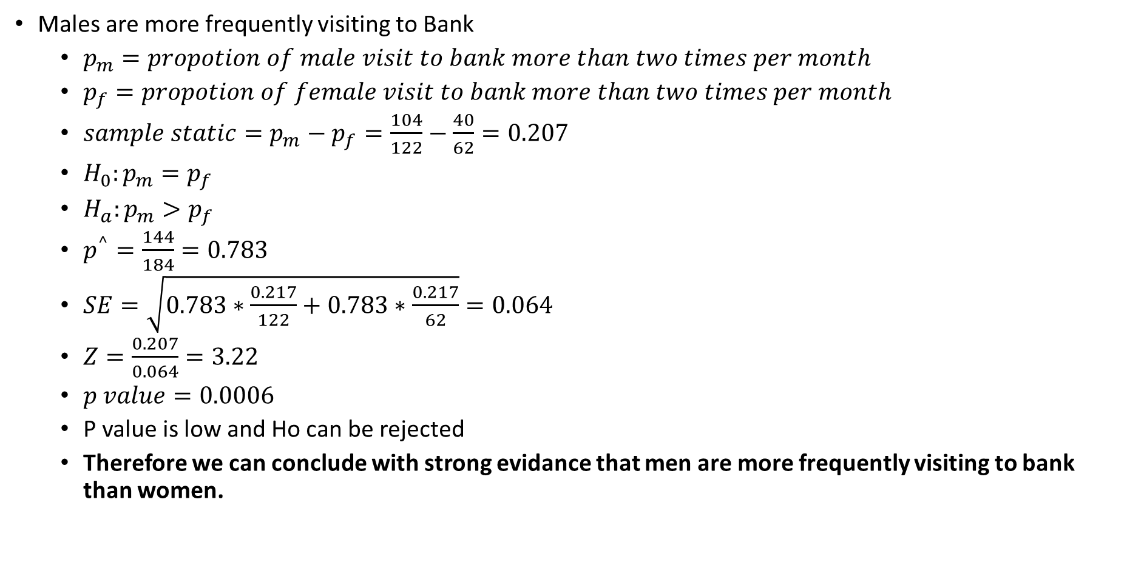
Statistical Inference-Visiting Frequency to Bank
209400C-Hasitha Jayasundara
Males are more frequently visiting to Bank
$p_{m}=propotion of male visit to bank more than two times per month$
$p_{f}=propotion of female visit to bank more than two times per month$
$sample static=p_{m}−p_{f}=\frac{104}{122}−\frac{40}{62}=0.207$
$H_{0}:p_{m}=p_{f}$
$H_{a}:p_{m}>p_{f}$
$p^{^}=\frac{144}{184}=0.783$
$SE=\sqrt{0.783∗\frac{0.217}{122}+0.783∗\frac{0.217}{62}}=0.064$
$Z=\frac{0.207}{0.064}=3.22$
$p value=0.0006$
P value is low and Ho can be rejected
Therefore we can conclude with strong evidance that men are more frequently visiting to bank than women.
Visit More than two times per month | Male | Female | Total
Yes | 104 | 40 | 144
No | 18 | 22 | 40
Total | 122 | 62 | 184

Slide 11
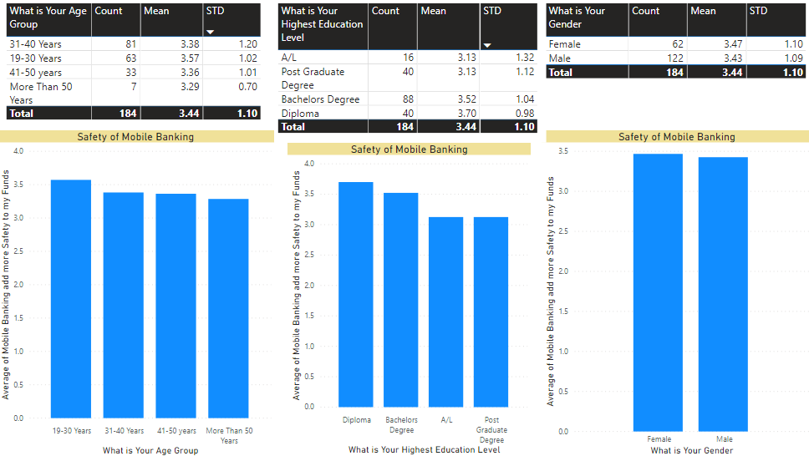
Safety of Mobile Banking
209400C-Hasitha Jayasundara

Slide 12
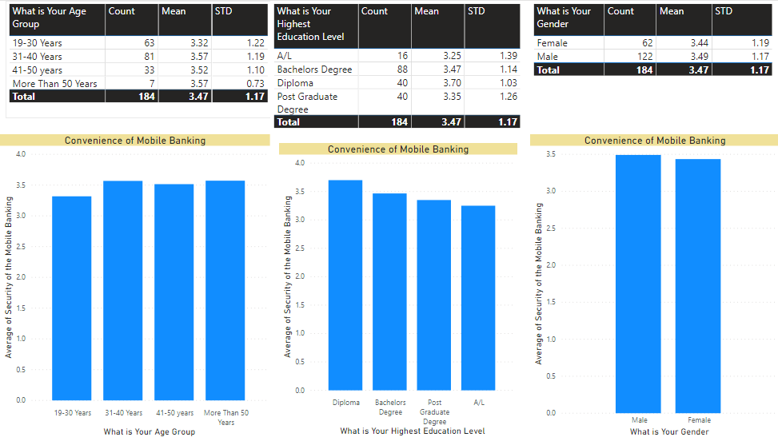
Convenience of Mobile Banking
209400C-Hasitha Jayasundara

Slide 13
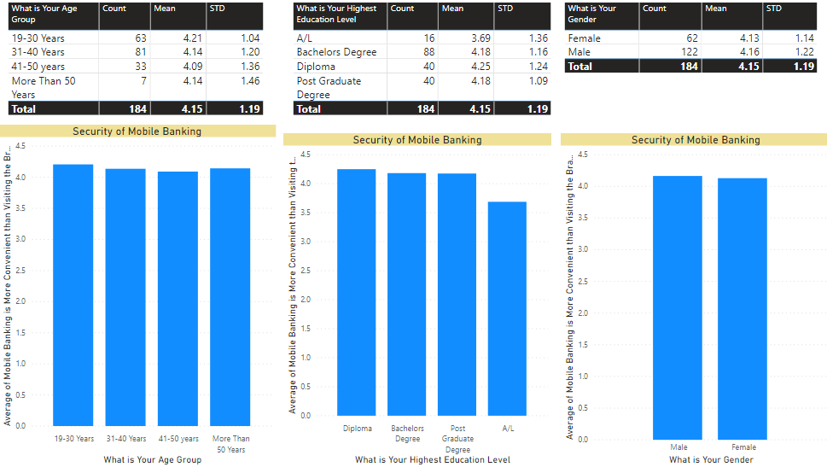
Security of Mobile Banking
209400C-Hasitha Jayasundara

Slide 14
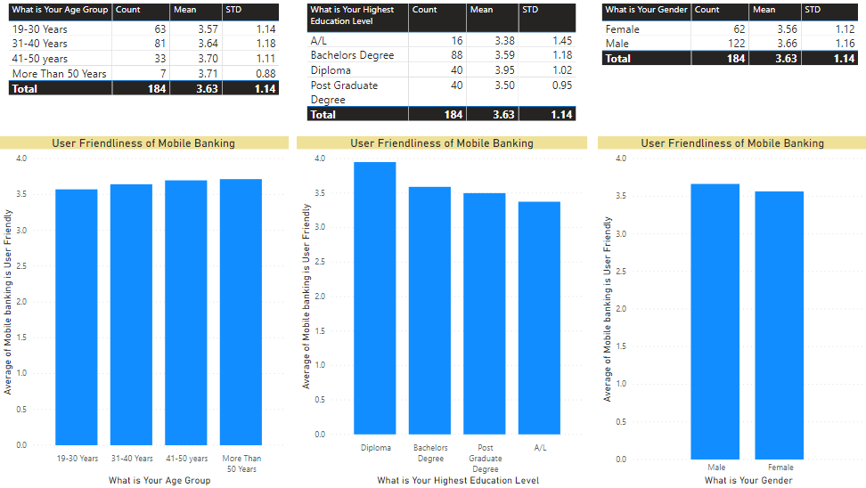
User Friendliness of Mobile Banking
209400C-Hasitha Jayasundara

Slide 15
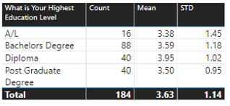
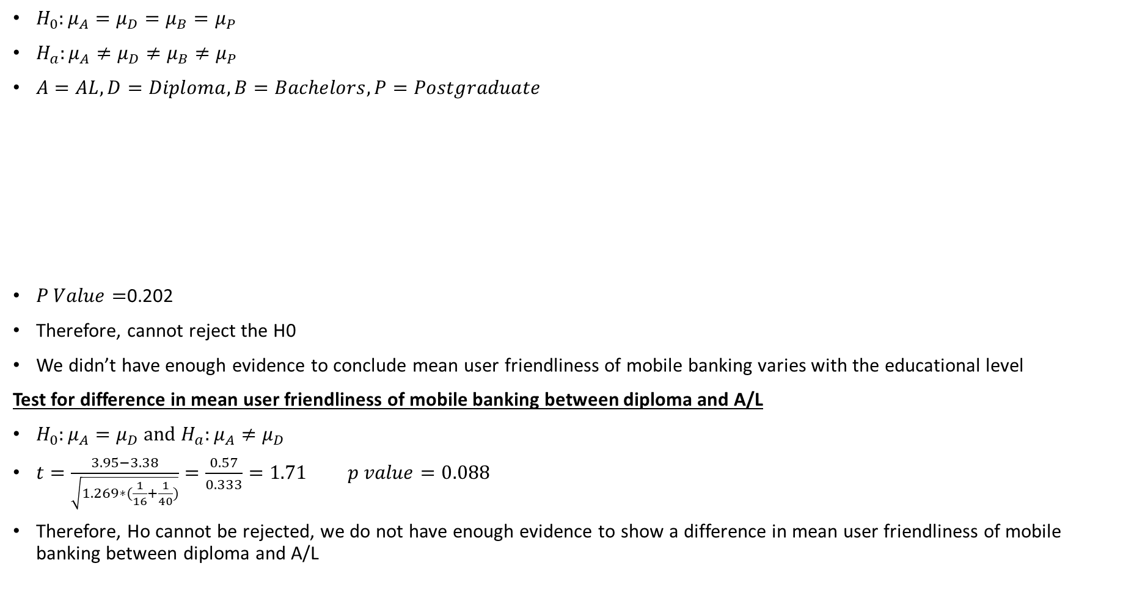
ANOVA for user friendliness of Mobile Banking among different education levels
209400C-Hasitha Jayasundara
$H_{0}:μ_{A}=μ_{D}=μ_{B}=μ_{P}$
$H_{a}:μ_{A}≠μ_{D}≠μ_{B}≠μ_{P}$
$A=AL,D=Diploma,B=Bachelors,P=Postgraduate$
$P Value=$0.202
Therefore, cannot reject the H0
We didn’t have enough evidence to conclude mean user friendliness of mobile banking varies with the educational level
Test for difference in mean user friendliness of mobile banking between diploma and A/L
$H_{0}:μ_{A}=μ_{D} and{ H}_{a}:μ_{A}≠μ_{D}$
$t=\frac{3.95−3.38}{\sqrt{1.269∗(\frac{1}{16}+\frac{1}{40})}}=\frac{0.57}{0.333}=1.71 p value=0.088$
Therefore, Ho cannot be rejected, we do not have enough evidence to show a difference in mean user friendliness of mobile banking between diploma and A/L
Source | df | Sum of Squares | Mean Square | F Static
Groups | 3 | 5.9128 | 1.97093333 | 1.55293908
Error | 180 | 228.4494 | 1.26916333
Total | 183 | 237.8268

Slide 16

Thank You

